Slide 1
Image Rights in the Caribbean – A Comparative Analysis f Spanish Speaking Perspective
Jose A. Santana
jsantana@bll.com.do

Slide 2
General Concepts
Personal Image
Image Rights
Representation or reproduction of the figure of a natural person.
Individual’s proprietary rights in their personality.
Ability to exploit and to prevent third parties from using, disseminating, reproducing or publishing an individual’s persona.
Non-material damage
Inconvenience caused by the mere observation of an unauthorized use of an individual’s personal image.

Slide 3
Non –patrimonial right
Image Rights
Pecuniary content

Slide 4
Passive or defensive:
Right to privacy - prevent fixation of the image by third parties
Active or offensive:
Right to publicity - commercial exploit of personal image
Double content of
Image Rights

Slide 5
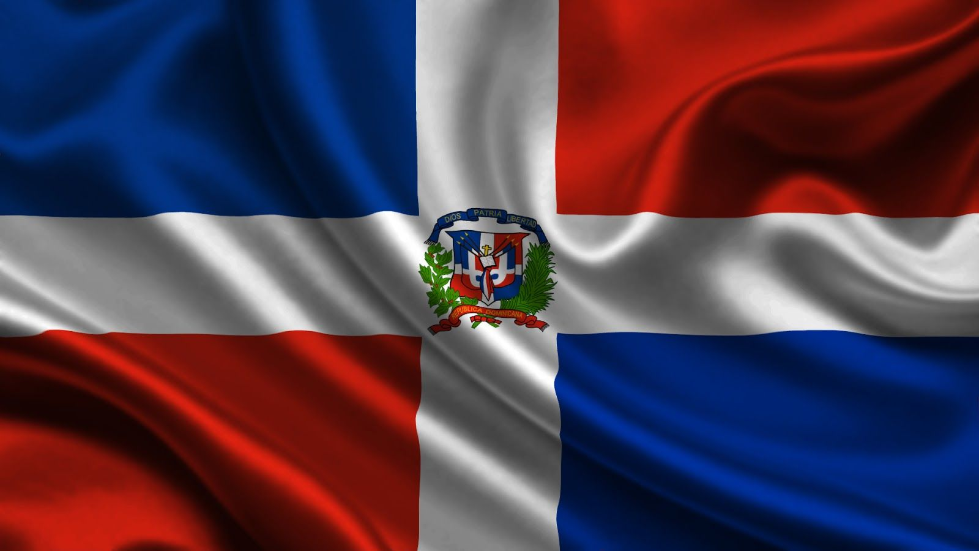
Image Rights in the Dominican Republic
Right to Honor and Right to Privacy

Slide 6
Universal Declaration of Human Rights of the United Nations of 10 December 1948
American Declaration of the Rights and Duties of Man of 1948
Inter-American Convention on Human Rights (Pact San Jose) of November 22, 1969
International Covenant on Civil and Political Rights of December16, 1966
International instruments
Protection of Honor, Privacy, Dignity: Personal Image

Slide 7
“2) All persons have the right to access to the information and facts about them or their property that reside in official or private registers, as well as to know the destination and the uses of the same, with the limitations fixed by law. Treatment of personal facts or information or that regarding property shall be made respecting the principles of quality, lawfulness, loyalty, security, and finality. One may solicit the updating, oppose the treatment, rectification, or destruction of that information that illegitimately affects his rights from before the appropriate judicial authority”
—Article 44, paragraph 2 - Dominican Constitution (2015)
Image Rights: Fundamental Rights

Slide 8
“The publication of a portrait shall be free where it relates to scientific, educational or cultural purposes in general or to facts or events of public interest or that have occurred in public”
—Article 36, of the Copyright Law No. 65-00
Image Rights – Copyright Law

Slide 9
—Article 52, of the Copyright Law No. 65-00
“Any person shall have the right, within the limitations established in the present Law, to prevent a bust or portrait of himself from being exhibited or placed on the market without his express consent or, where he is deceased, the consent of his heirs or successors in title. Any person that has given his consent may withdraw it but shall remain liable for damages ”
Image Rights – Copyright Law

Slide 10
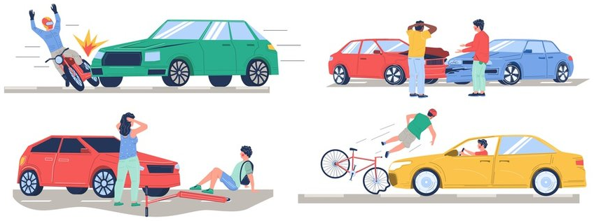
Law No. 20-00 on Industrial Property
A symbol cannot be registered as a trademark: “would affect the personal rights of a third party, especially regarding … portrait of a person… unless consent is granted…”.
Law No. 192-19 on the Protection of the Image, Honor and Family Privacy of Deceased and Injured Persons
Establishes as unfair competition acts those that imply taking undue advantage of the fame or the reputation of a person…
Injured persons or family of a deceased person can claim the protection of their rights to privacy and personal image.
A civil and expedite action for compensation is available
Free use 20 years after death - Non-offensive reproduction
Exceptions (personal, authorized, or investigative use)
Other image rights laws

Slide 11
Law No. 24-97 on Domestic Violence and Violence Against Women
Law No. 136-03, which creates the Code for the System for the Protection and Fundamental Rights of Children and Adolescents
Minors have the right to… respect for dignity,... the preservation of their image...
Capture, record or transmit, without consent, the image of a person who is in a private place.
1 to 2 years imprisonment and 50,000 to 100,000 DOP fine:
Publishing, by any means whatsoever, of the montage made with image of a person without his knowledge…
Prohibition to dispose image of minors affecting physical, moral, psychological and intellectual development,.. honor, reputation and self-image…
Penalties: 2 to 4 years and fines who violate the integrity of minors by photographing, filming, or publishing.
6 months to 1 year imprisonment - 25,000 to 50,000 DOP fine:
1 to 5 years and fines who employs minors in audiovisuals that depict explicit content
Other image rights laws

Slide 12
Habeas data
Constitutional remedy available to every individual, that allows to access any database, record of data and references about said individual, without the need to explain reasons, while at the same time allows to request the correction of that information that causes any harm.
Constitution and Law 137-11
Other image rights laws

Slide 13
Image Rights Case Law
Zoila Luna
vs.
Cervecería Nacional Dominicana, C. por A.

Slide 14
Zoila Luna vs. Cervecería Nacional Dominicana, C. por A.
Image Rights Case Law
Claims
Decision
Unauthorized use of self-image in commercial, valuable reputation of claimant (veteran TV-Radio host)
Recording in public event but not fitted within exceptions.
Commercial exploitation of claimant’s image.
Moral damage was caused interference of individual’s self determination.
Defense
Image was taken in an interview during a launch product event of the brand and use as “infomercial”, not as a public figure, but a normal person

Slide 15
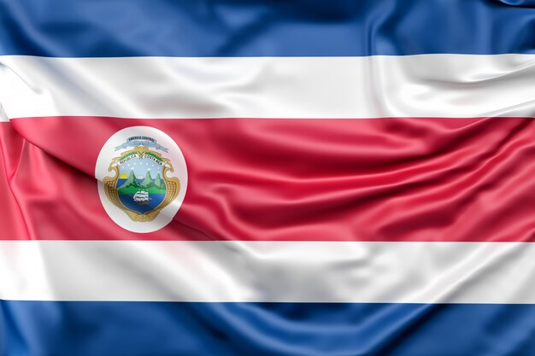
Image Rights in Costa Rica

Slide 16
Image Rights in Costa Rica
Art. 29
Constitution
Arts. 47 and 48
Civil Code
Art. 196
Criminal Code
Right to privacy, freedom and secrecy of communications

Slide 17
Image Rights in Costa Rica
Essential component and manifestation of personality rights… to safeguard the private sphere of individuals from public scrutiny, unless authorized.
For minors, consent/authorization of image within the limits of reasonableness and proportionality.
Right to honor, reputation, privacy and self-image are limited by freedom of information and State's capacity to investigate criminal cases.

Slide 18
Image Rights in Colombia
Autonomous and very personal right

Slide 19
Law 23 of 1982 and Andean Community Decision 351
Self-image is autonomous and very personal right
Prevent the public display of an individual's image without consent
Image rights over copyright in the case of photographs
Image Rights in Colombia

Slide 20
Image Rights in Colombia
Image right: an expression of individuality, identity and human dignity.
Less strict for public figures and public acts due to human sociability, freedom of information and expression.
Attendance at public events/spaces implies a waiver of privacy – use image is allowed.

Slide 21
Image Rights in the Caribbean – A Comparative Analysis f Spanish Speaking Perspective
Jose A. Santana
jsantana@bll.com.do

